Slide 1

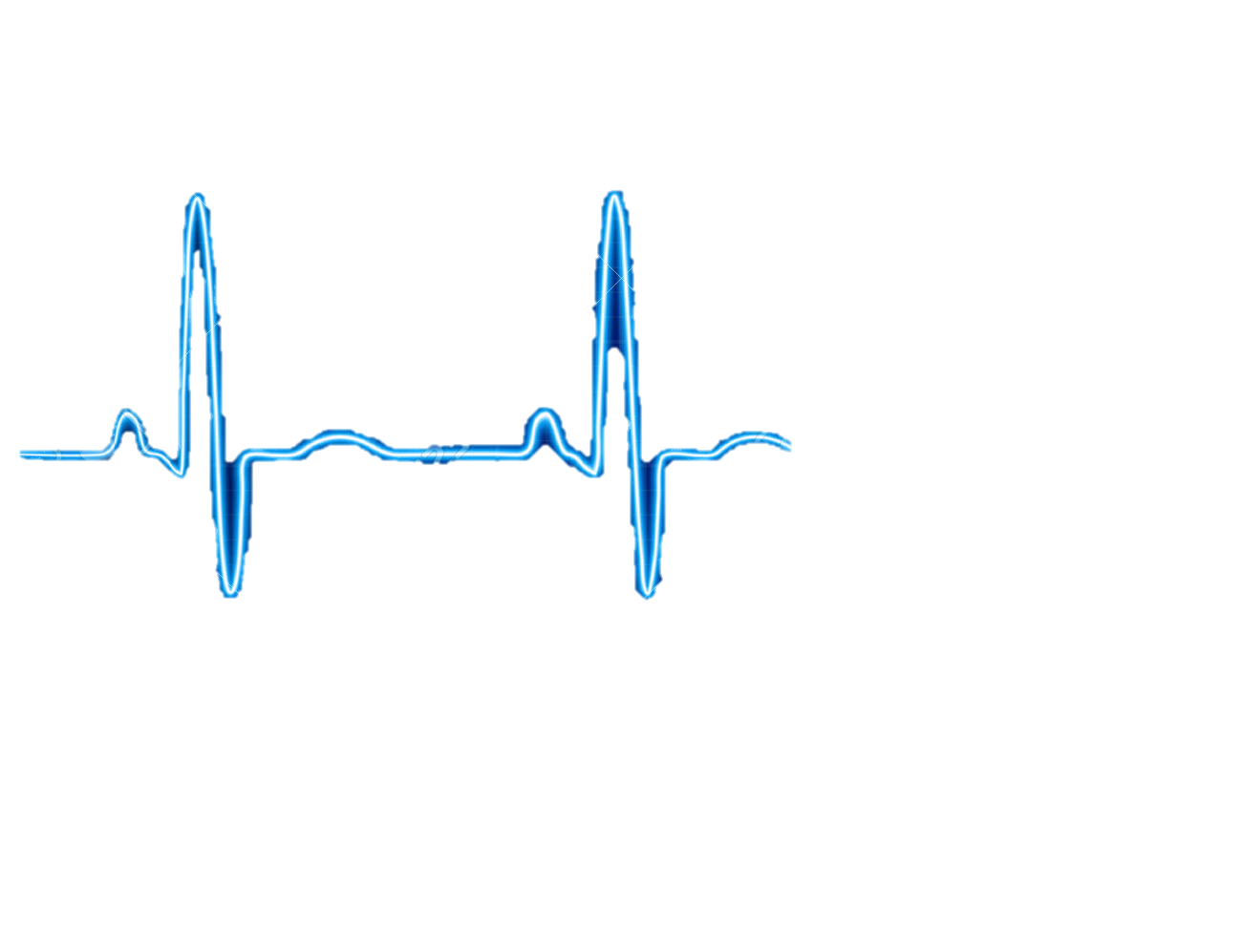
NEED FINDING
CARDIOVASCULAR TEAM
Qingbo Kang
Arthur Kohler
Chantelle Janeiro
Naghmeh Bandari
November, 2017

Slide 2
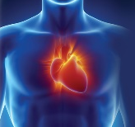

AGENDA
Team Members
Observations
Need Identification
Need Screening
Top Five Need Statements

Slide 3
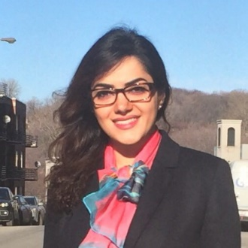
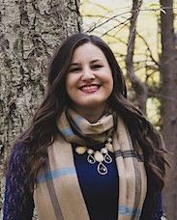
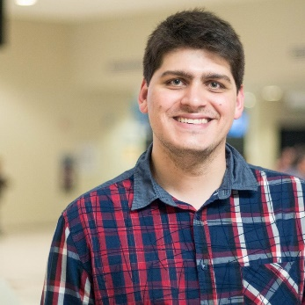
TEAM MEMBERS
Naghmeh Bandari:
- PhD. Student of Mechanical engineering, Concordia University (2016-Now)
- Therapy Development Specialist, CoreValve® TAVI, Medtronic® lnc. (2010-2015)
- Commerce and Regulatory Affairs Supervisor, Thoratec Corp. (2007-2010)
Chantelle Janeiro:
- MSc., Year 1, McGill University, Department of Experimental Medicine (Present)
Supervisor: Dr. Lorenzo Ferri; Research: Gastric Adenocarcinoma Peritoneal Metastasis
- BMSc., University of Western Ontario (2012-2017), Microbiology and Immunology
Arthur Kohler:
- Master Student in Engineering, with a concentration in Healthcare , ÉTS (2016-Now)
- Student in Biomedical Engineering, University of Technology of Compiègne, France (2014-Now)
Qingbo Kang:
- Master Student of Computer Science, Concordia University (2017-Now)

Slide 4
Observation
5 Hospital Visits
Two general visits, Glen Hospital, with Dr. Galli
One Coronary Artery Bypass Grafting (CABG), Glen Hospital, with
Dr. Lachapelle, Dr. Cecere
Two Transcatheter Aortic Valve Implantation (TAVI), Glen Hospital
With Dr. Lachapelle, Dr. Piazza

Slide 5
Need Identification
Total number of identified needs: 99

Slide 6
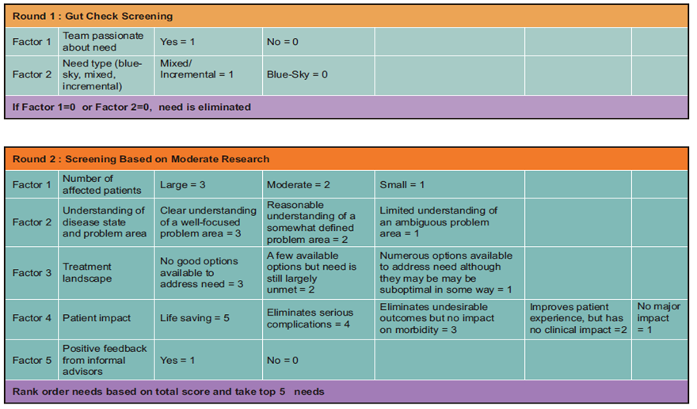
Number of Needs
Need Screening
99
25
5

Slide 7
Need 1:
A way to overcome the lack of wireless charging for medical devices that require an external power source, such as ventricle assist device, in patients with congestive heart failure, in order to improve convenience, maintenance, portability and quality of life.
Disease status:
Heart failure (HF) is a condition that the heart's pumping power is lower than healthy level. Consequently, the heart is not capable of pumping demanded oxygen and nutrients to the body.
At least 26 million patients worldwide
5.7 million people in the US
It is expected that by 2030 more than 8 million people will have this condition, with 46 % increase in prevalence

Slide 8
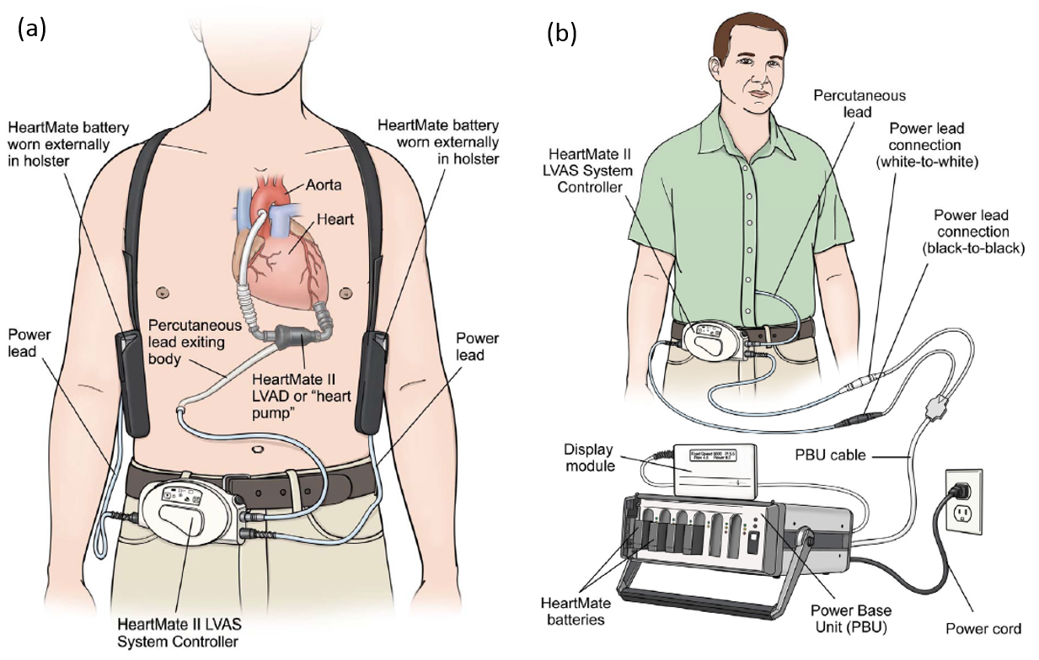
Need 1
Existing Treatment and Problem
Heart failure could be treated by Ventricle Assist Device (VAD), a small implantable device that act to compensate the pumping function of the heart and assist in circulating blood throughout the body.
VADs systems consist pump, system controller, power source, power leads, batteries and battery clips
VADs must always have power, either from batteries or electricity from the wall outlet
A power module or AC adaptor is used when the patient is not active, like when he is watching TV. It must be used when he is sleeping
Batteries should be exchanged when their charge falls below 25% capacity
Fully charged batteries should always be available or carried by backup bag

Slide 9
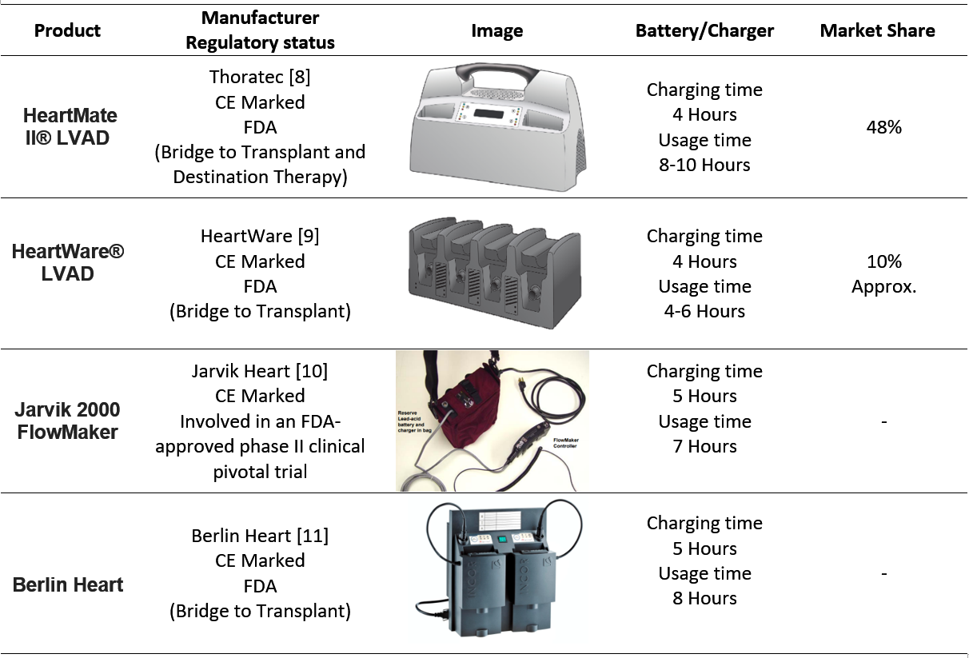
Need 1
Competitors

Slide 10
Need 1
Current Market for cardiac assistive devices
US | Global
770$ Million | 1.4$ Billion | Market Value (2017)
10.9% | 8.6% | CAGR (2010-2017)
Classification and Applicable Regulations for battery chargers for VAD
FDA-CDRH | CE | HEALTH CANADA
Device Classification: 1 Product Code: KRF Regulation Number: CFR 870.3670 | Device Classification: I Regulation: EEC/2017/745 | Device Classification: I Regulation: CMDCAS
Need Criteria:
the proposed need is subjected to the following criteria:
Lightweight, easy to carry
No need to backpack for reserve battery set
Firmware to track flows and battery charge with phone application

Slide 11
Need 2:
A way to reduce the tediousness of counting surgical instruments in every surgery, which will increase the efficiency of medical procedures, lighten the workload of operating room staff, and decrease surgical complications caused by human error.
Background:
Counting all surgical instruments before and at the end of surgery is an important process for every surgery.
Retained surgical instrument (RSI) could lead to severe problems to patients.
At present, the surgical instruments counting process generally is undertaken by human, thus, mistakes is inevitable.
Mistakes in instruments counts happened in 12.5% of surgeries. – Annals of Surgery

Slide 12
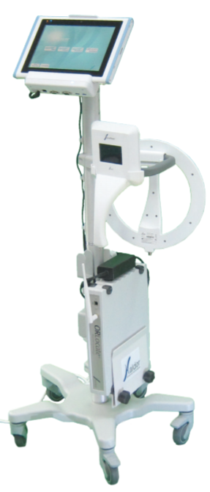
Need 2
Existing Treatment and Problem
Israel RFID (radio frequency identification) medical solution provider Haldor Advanced Technologies developed ORLocate system based on passive RFID tags, it can monitor and track the surgical instruments before, during and at the end of the surgical procedure.
Penelope robot system designed by Micheael R.T can also count surgical instruments.
Most existing solutions are based on ceramic RFID tag.
Need to change the manufacturing process of surgical instruments.
Complex and the price is pretty high.

Slide 13
Need 2
Market and Competitors
48 million surgical inpatient procedures were performed in the United States in 2009. – National Center for Health Statistics
The number of cases in which surgical instruments are left behind during a procedure in the United States has been estimated at around 1500 cases per year, while approximately 88% of these cases occur in a situation where the surgical instruments counts were declared “correct”.
The compensation costs associated with RSI are high. Costs vary from $37,041 to $ 2,350,000 per incident, with an average cost per case estimated at $95,000.
48 million surgical inpatient procedures were performed in the United States in 2009. – National Center for Health Statistics
The number of cases in which surgical instruments are left behind during a procedure in the United States has been estimated at around 1500 cases per year, while approximately 88% of these cases occur in a situation where the surgical instruments counts were declared “correct”.
The compensation costs associated with RSI are high. Costs vary from $37,041 to $ 2,350,000 per incident, with an average cost per case estimated at $95,000.
A more accurate and efficient surgical counting approach would help to save these costs and benefit to both patients and hospitals.

Slide 14
Need 2
Classification and Applicable Regulations
FDA-CDRH | CE | HEALTH CANADA
Device Classification: 1 Product Code: LWH Regulation Number: CFR 880.2740 | Device Classification: I Regulation: EEC/2017/745 | Device Classification: I Regulation: CMDCAS
Need Criteria:
The aiming approach should not change the fabrication process of surgical instruments.
The aiming approach should be more accurate than these existing approaches.
The aiming approach should be easy to use.
The aiming approach should be low-cost.

Slide 15
Need 3:
A better way to distinguish vessels that need to undergo bypass in pre-operative imaging for the coronary artery bypass graft (CABG) procedure,
in order to speed up diagnosis, and to increase the accuracy of medical professionals in emergency cases.
Disease status

Slide 16
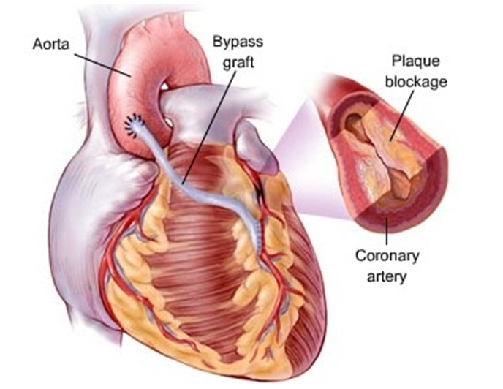
Need 4
Existing Treatment and Problem
Coronary artery bypass is the usual treatment for relieving the symptoms of coronary artery disease
CABG is an open heart surgery where the person is placed in general anesthesia
The blood circulation is managed by a heart-lung machine, which allows the surgeon to clamp the aorta, and use a vein taken in the leg to bridge the aorta coronary artery
It is also possible to perform the same surgery with heart-beating procedure, to avoid the technical complications of the machine
the diagnosis is not always easy to emit

Slide 17
Need 3
Market and Competitors

Slide 18
Need 3
Classification and Applicable Regulations
FDA-CDRH | CE | HEALTH CANADA
Device Classification: 1 Product Code: Regulation Number: | Device Classification: III Regulation: EEC/2017/745 | Device Classification: III Regulation: CMDCAS
Need Criteria:

Slide 19
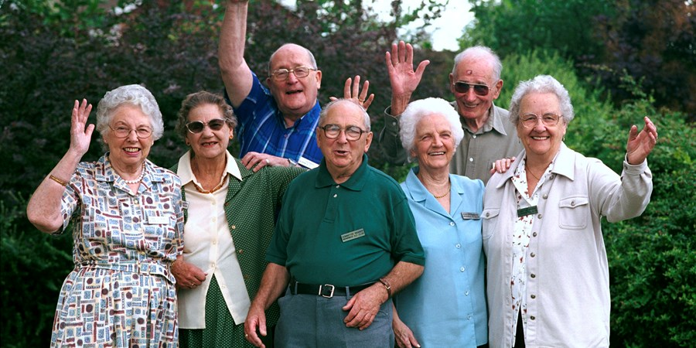
Need 4:
A way to more accurately determine the size of a heart valve during transcatheter valve replacement, in order to increase the accuracy and efficiency of choosing the proper valve.
1990 2050
Disease state:
Elderly population (80 years+) expected to increase
Prevalence in ~1 in 8 elderly aged 75 years+
6.9 M
25 M

Slide 20
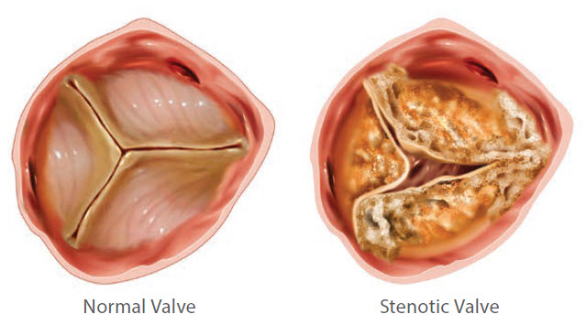
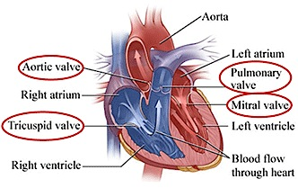
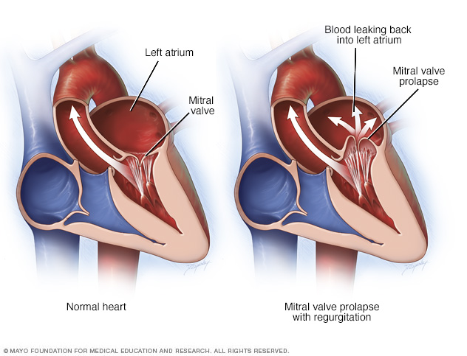
Disease State
Need 4
Valve disorders:
stenosis
prolapse
regurgitation
Stenosis: valve is sufficiently narrowed or stiffened.
Prolapse: leaflets don’t close evenly and collapse backward into the chamber that they are supposed to be sealing off.
Regurgitation: backflow of blood into the improper chamber.
Those at risk for valve disorders:
high blood pressure,
coronary artery disease,
rheumatic fever,
infective endocarditis,
heart attack or failure,
arrhythmias,
birth defects,
mediastinal (chest) radiation therapy for cancer

Slide 21
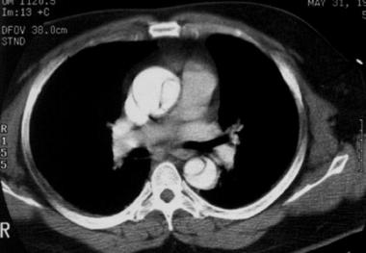
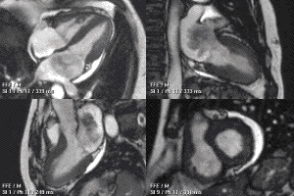
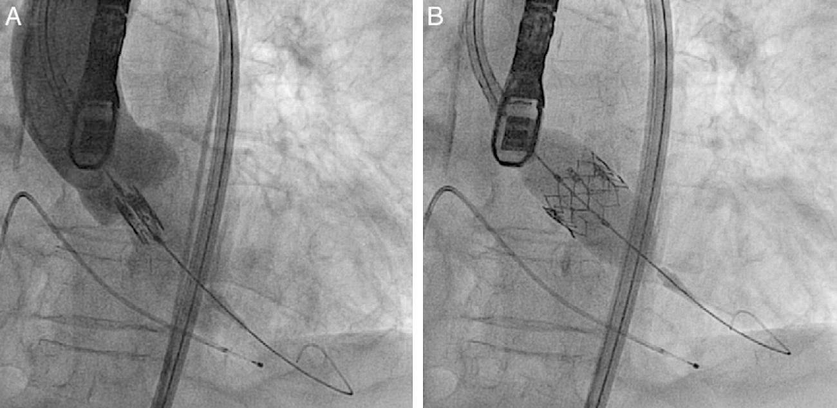
Need 4
Existing Treatment and Problem
percutaneous coronary intervention (PCI)
transcatheter aortic valve implantation (TAVI)
low-risk patients may leave same day
Open-heart valve replacement surgery
stop heart beating
heart/lung machine
several weeks recovery
PROBLEM: vessel measurements may vary based on the phase of the cardiac cycle.
improper valve sizing can lead to perioperative or post-operative
complications such as paravalvular aortic regurgitation.

Slide 22
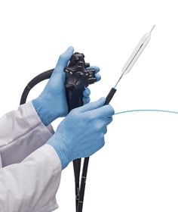
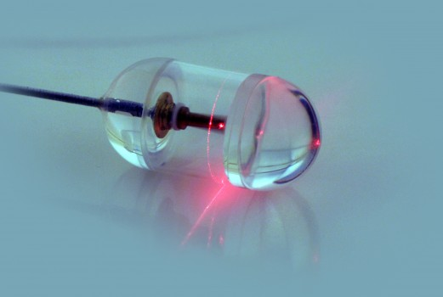
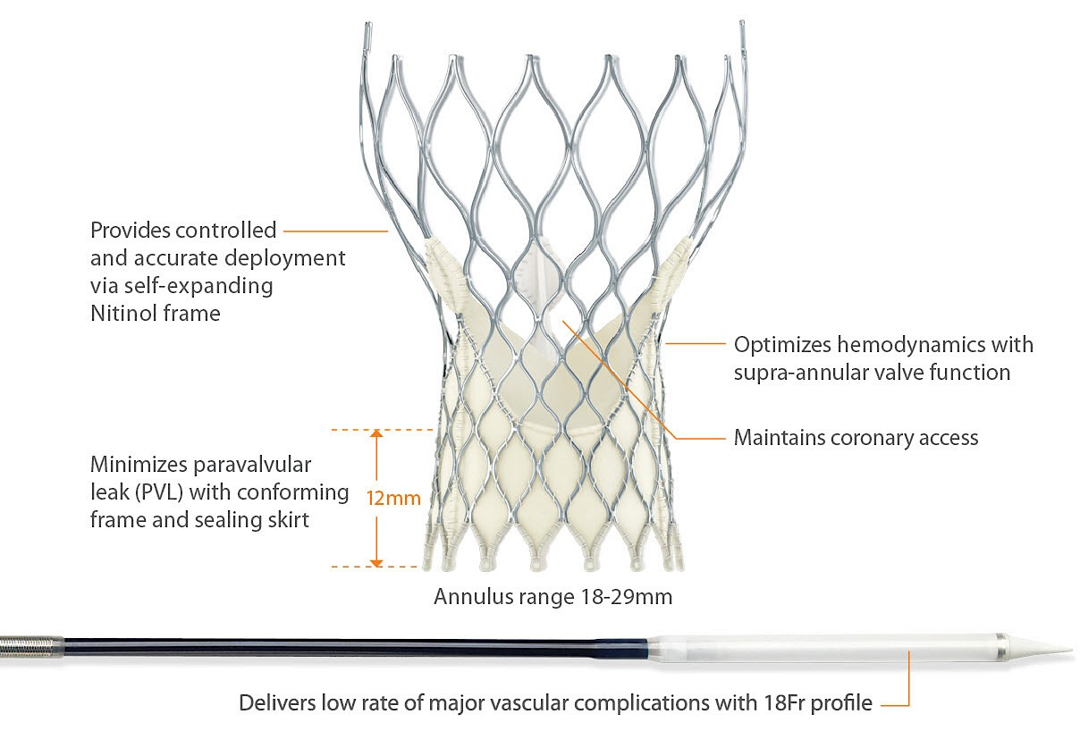
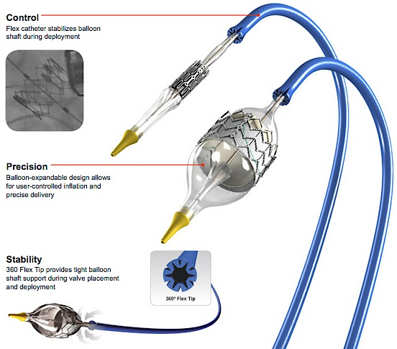
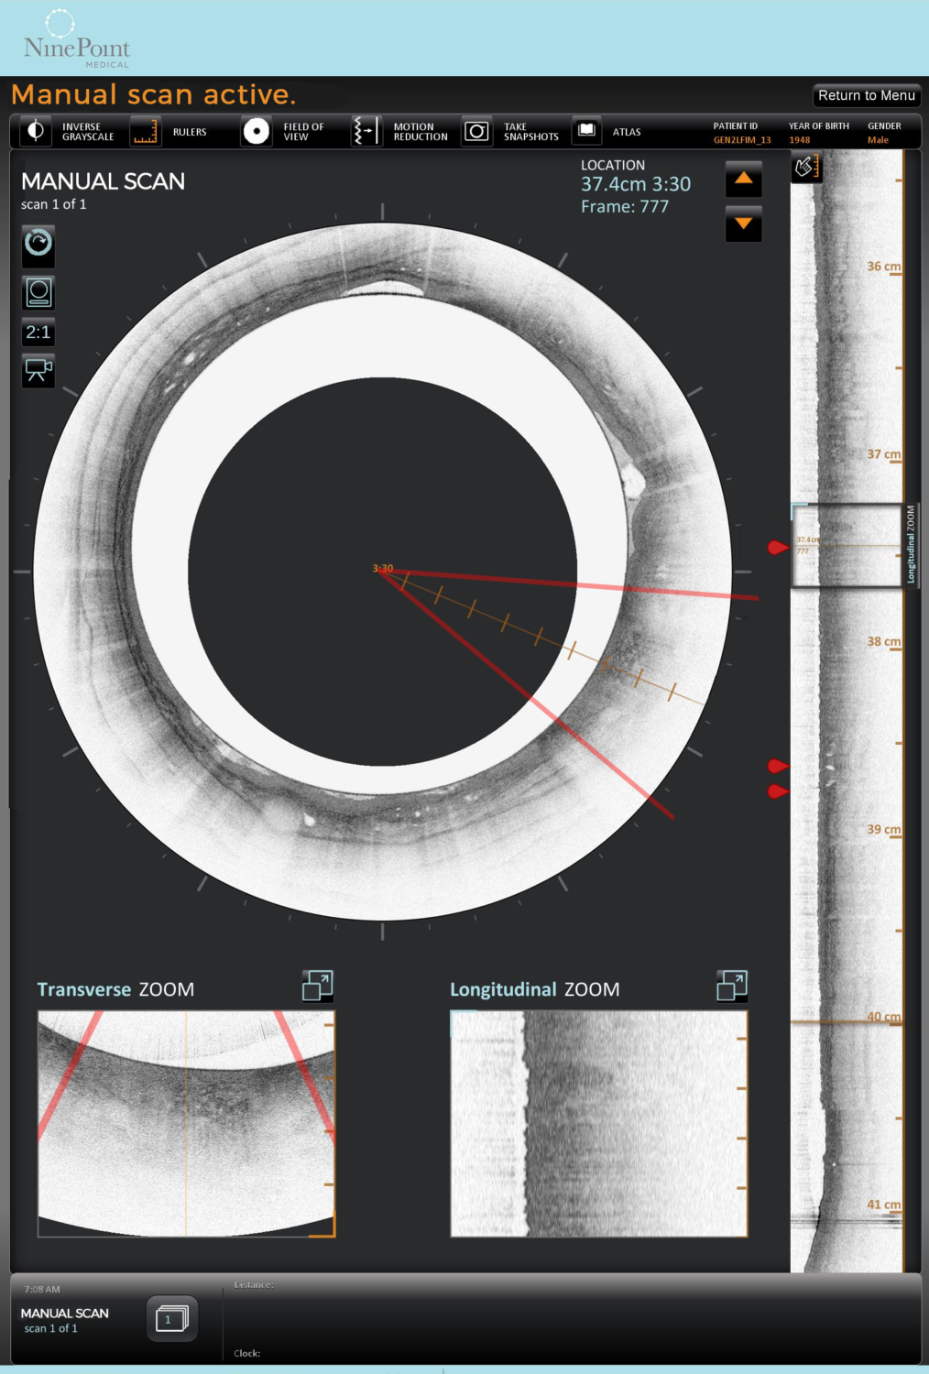
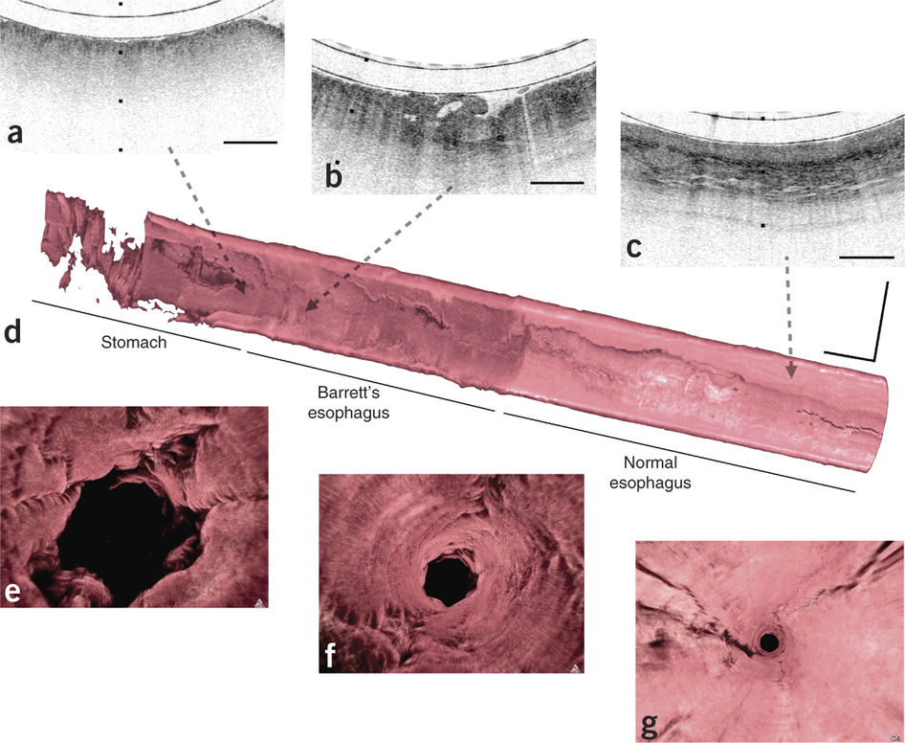
Need 4
Market and Competitors
Self-expandable Medtronic
CoreValve
- Balloon-expandable Edwards
SAPIEN XT valve
- Edwards NovaFlex+ catheter
Nvision VLE Imaging
System
(NinePoint Medical)
Tethered Capsule Endomicroscopy
(Harvard Medical School)
*CT Scanners: GE Healthcare, Philips, Siemens, Toshiba*

Slide 23
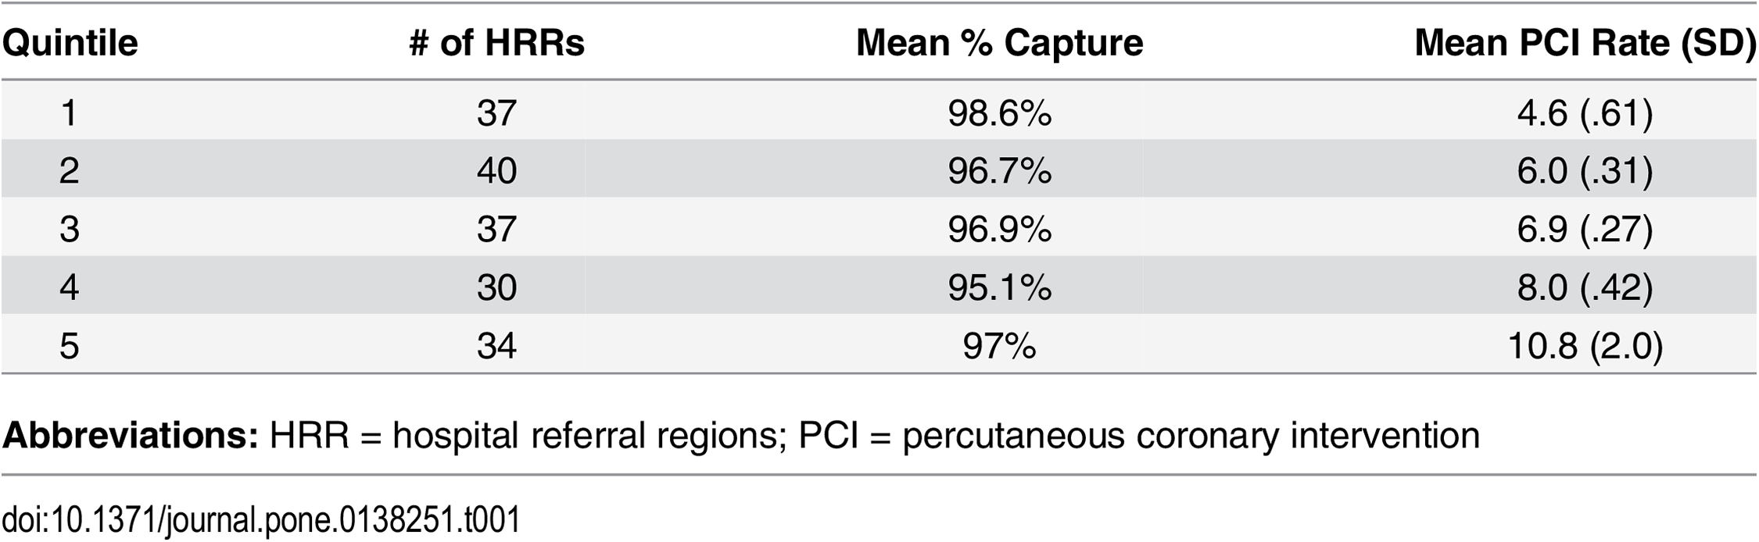
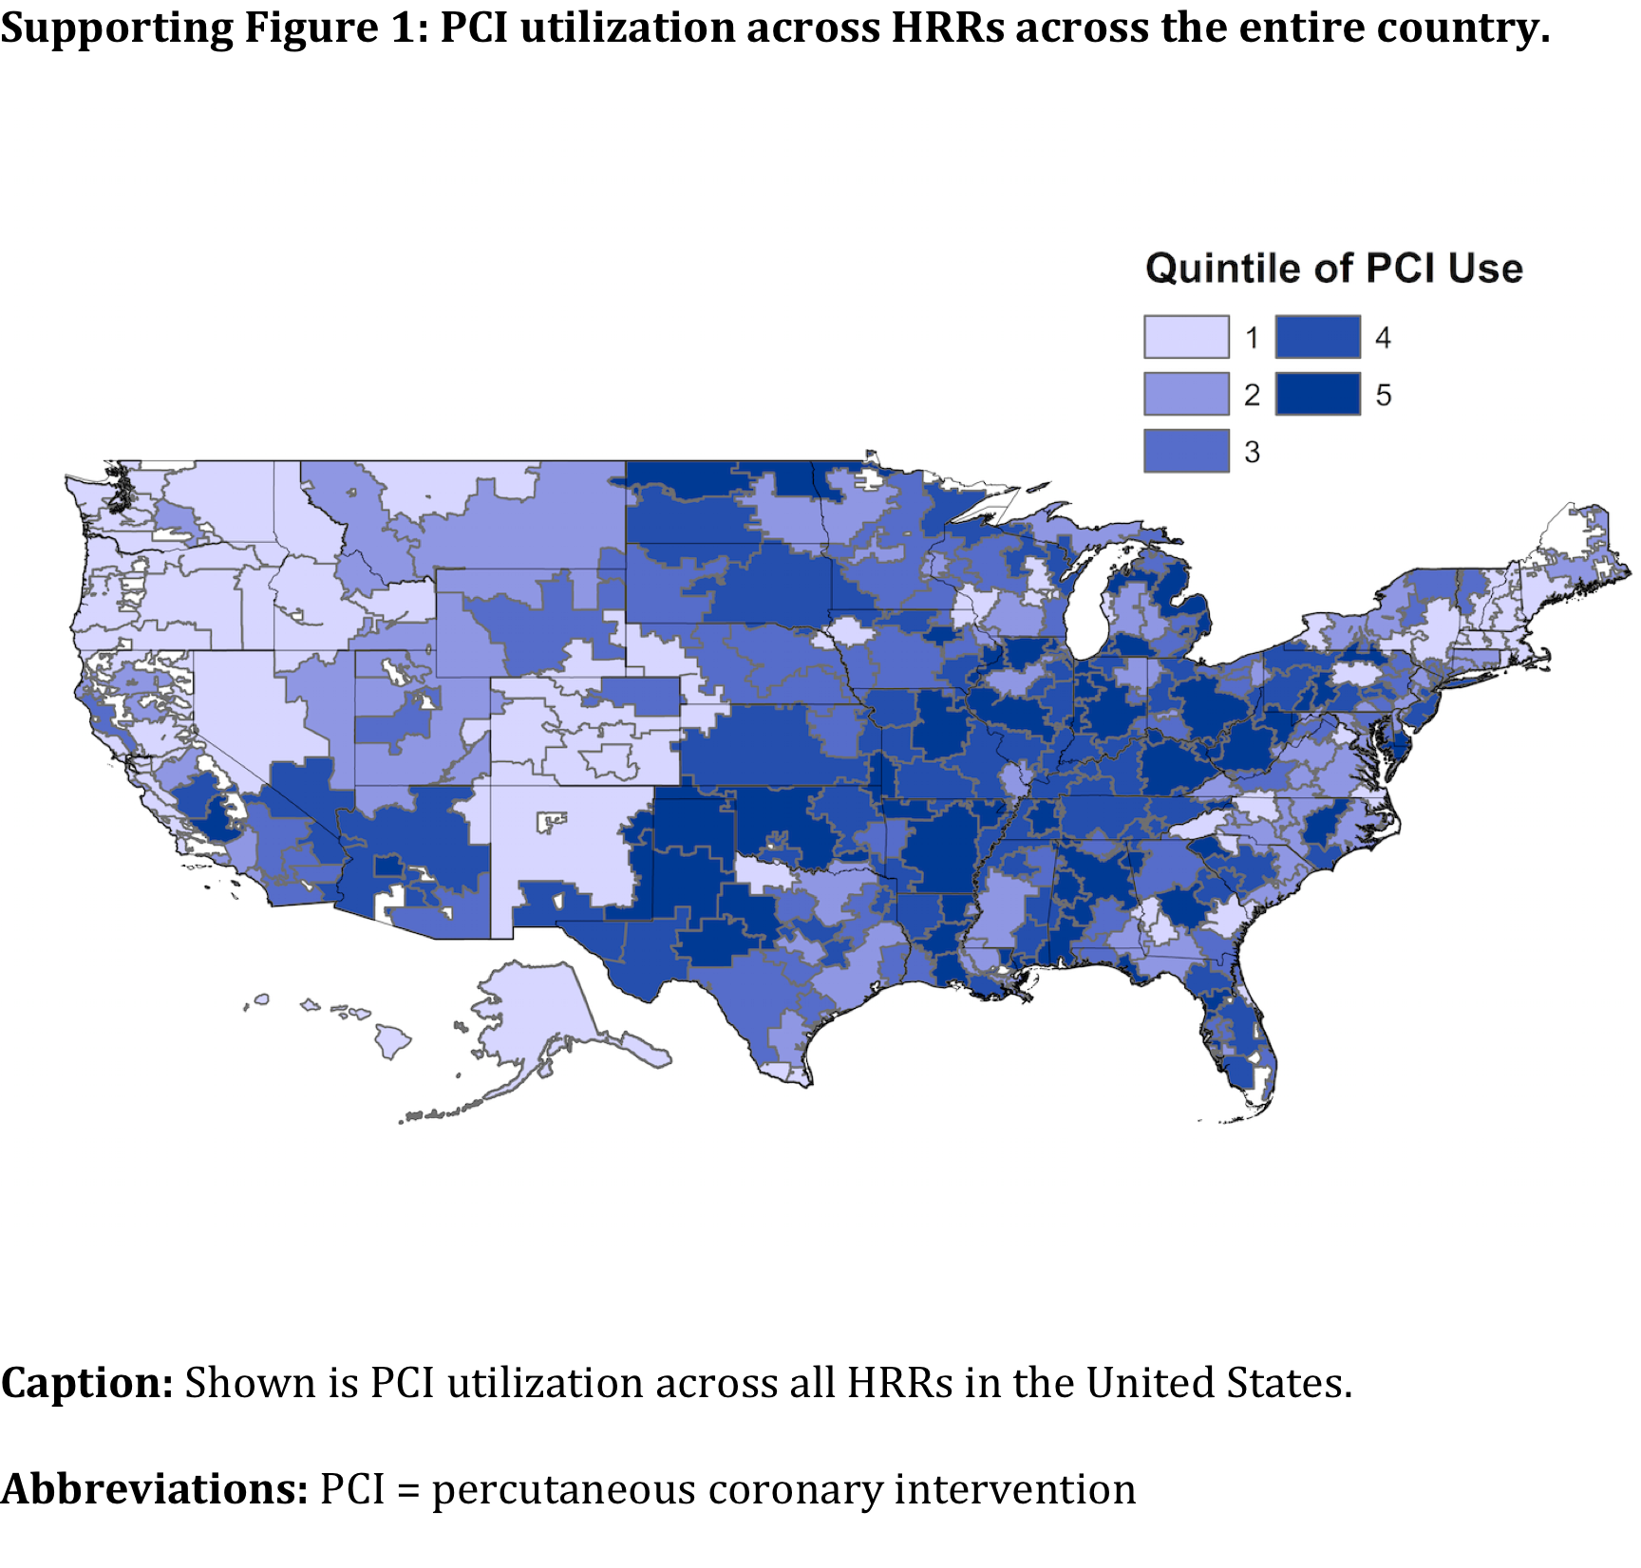
Need 4
Market and Competitors
Matlock, D.D., et al. JAMA. 2013; 310(2):155-62.

Slide 24
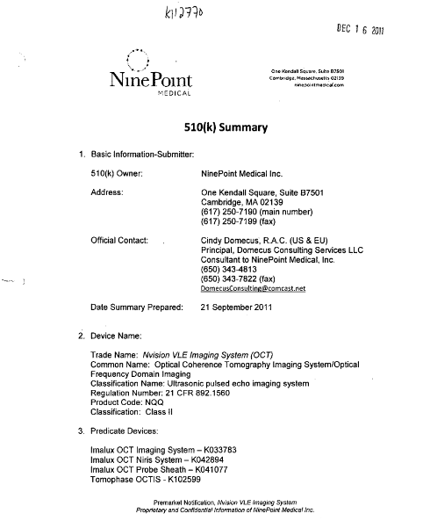

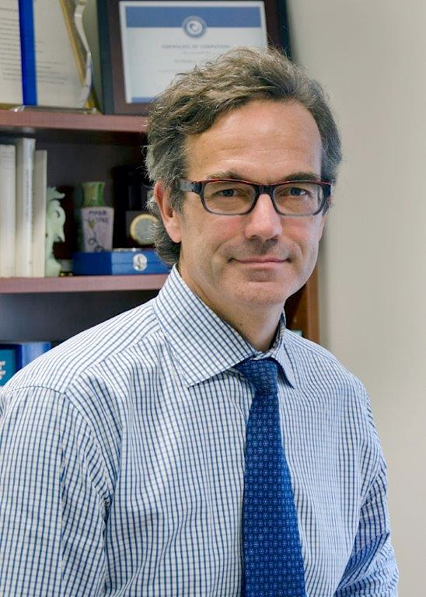
Need 4
Classification and Applicable Regulations
Percutaneous transluminal coronary angioplasty catheters | Nvision VLE Imaging System (NinePoint Medical)
Device Classification: II Product Code: LOX Regulation Number: 870.5100 | Device Classification: II Product Code: NQQ Regulation: 21 CFR 892.1560
Need Criteria:
Have to be able to insert a diagnostic tool into a vessel that may be highly calcified.
Should be able to take a 360° image of the vessel and determine its diameter for sizing.
Key Opinion Leaders:

Slide 25
Need 5:
A way to improve surgical instruments identification for OR staff, students and residents during training surgeries, in order to accelerate their acquaintance with new instruments/sets.
Problem status:
Communication between the staff is complicated by different factors in the OR : machine noises, number of people in the room, misunderstanding or lack of knowledges, etc.
Contribution margin/hour of op. time = (hospital income generated by a surgical case) – (all variable costs of hospitalization and supply) → 62USD/min in OR !
An immersive training could be a key step to avoid misunderstanding problems, accelerate the formation and make it more efficient.

Slide 26
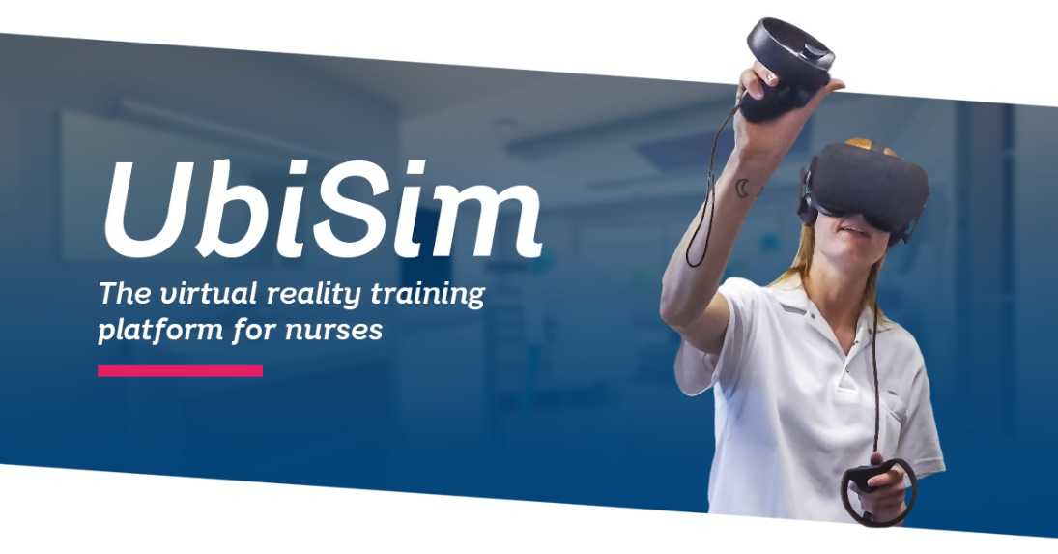
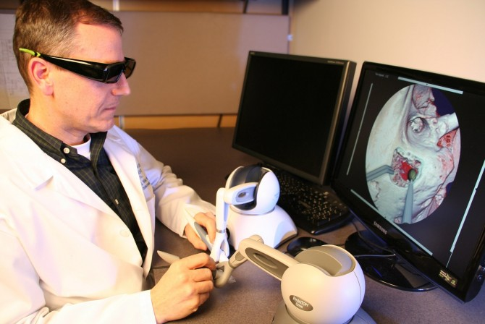
Need 5
Existing Treatment and Problem
Longer formations for people in OR : surgeons, anesthetists, specialized nurses, …
Immersive training with virtual reality more and more present, especially for surgeons though. Otherwise, the offer for immersive training is quite limited for the rest of the staff.
A lot of people are quite unexperimented for their first experience in OR.

Slide 27
Need 5
Market and Competitors

Slide 28
Need 5
Classification and Applicable Regulations
FDA-CDRH | CE | HEALTH CANADA
Device Classification: 1 Product Code: Regulation Number: | Device Classification: I Regulation: EEC/2017/745 | Device Classification: I Regulation: CMDCAS
Need Criteria:

Slide 29
CARDIOVASCULAR TEAM
Thank You…

